Slide 1

Competitive Programming From Problem 2 Solution in O(1)
P
T
H
I
N
K
F
A
S
T
S
C++: Practice - Multidimensional Arrays
Mostafa Saad Ibrahim
PhD Student @ Simon Fraser University

Slide 2
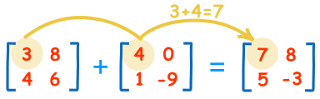
Matrix Addition
Src: http://www.mathsisfun.com/algebra/images/matrix-addition.gif

Slide 3
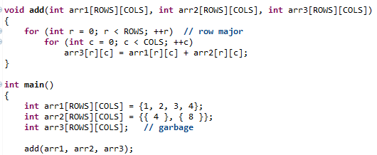

Matrix Addition
O(n^2)

Slide 4
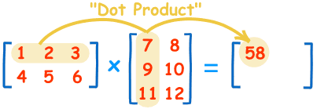
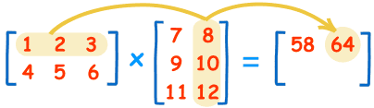

Matrix Multiplication
1*7 + 2*9 + 3*11 = 58
Matrix(2 x 3) * Matrix(3 x 2) = Matrix(2 x 2)
Notes:
https://www.mathsisfun.com/algebra/matrix-multiplying.html

Slide 5
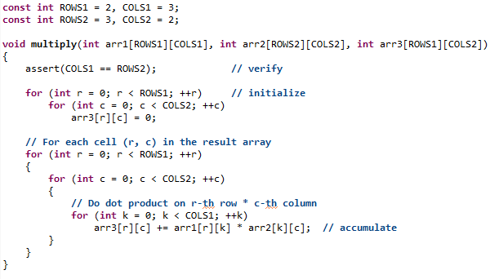
Matrix Multiplication
O(n^3)

Slide 6
Magic Square - Validation
It is square matrix with
Sum of any row
Sum of any column
Sum of any of the 2 diagonals is SAME
Given matrix: Check if it is valid Magic square

Slide 7
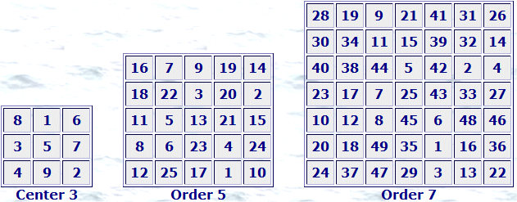
Magic Square - Validation
E.g. For 3x3: Any sum = 15
Notes:
Src: http://users.eastlink.ca/~sharrywhite/images/syml_s357.gif

Slide 8
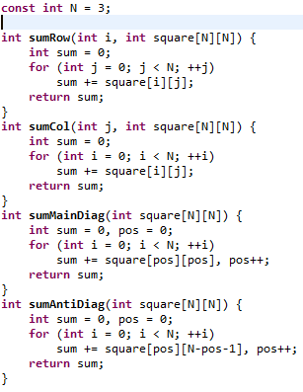
Magic Square – Validate 4 Directions

Slide 9
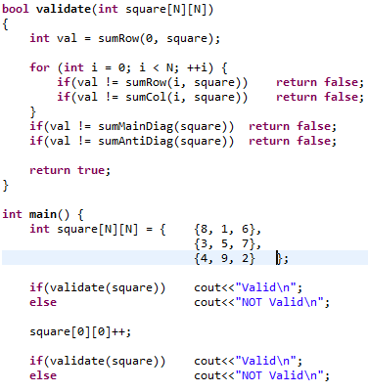

Magic Square – Call Validation

Slide 10
Trick: Direction Array
Moving in a specific direction in an array in any of 8 directions
(5, 3) => Down => (6, 3) = Dir (1, 0)
(5, 3) => Down Left => (6, 2) = Dir (1, -1)
(5, 3) => Right => (5, 4) = Dir (0, 1)
(-1, -1) | (-1, 0) | (-1, 1)
(0, -1) | (r, c) | (0, 1)
(1, -1) | (1, 0) | (1, 1)

Slide 11
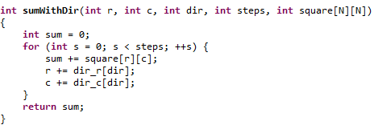

Magic Square – With Dirs
sumWithDir(0, 0, RIGHT, 3, square)
Remeber Right = (0, 1)
sum = 0 , r = 0, c = 0
sum = 8 , r = 0, c = 1
sum = 9 , r = 0, c = 2
sum = 15, r = 0, c = 3

Slide 12
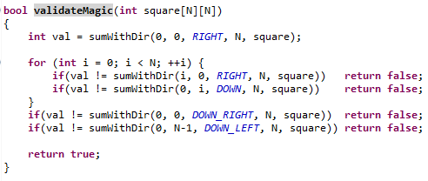
Magic Square – Validation

Slide 13
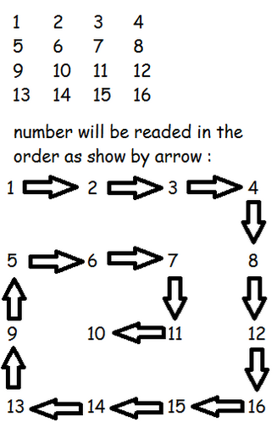
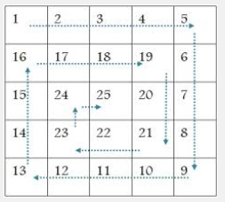
Spiral Matrix Order
Notes:
Src: http://www.cprogramto.com/spiral-matrix-in-c/
Src: http://4.bp.blogspot.com/-AcneqVltY3g/Uiy0JMTXuiI/AAAAAAAAAfA/xN5k_GyRJYg/s72-c/Spiral.jpg

Slide 14
Spiral Matrix Order: Analysis
Think more = Write/Debug less
Design Decision: Working with dir array is one good way
Other way, manual handling for the 4 directions
Anaylsis technique:
Simulate & Observe
Either start from the smallest N and generalize
Or from good size (e.g. N=6) and validate boundries

Slide 15
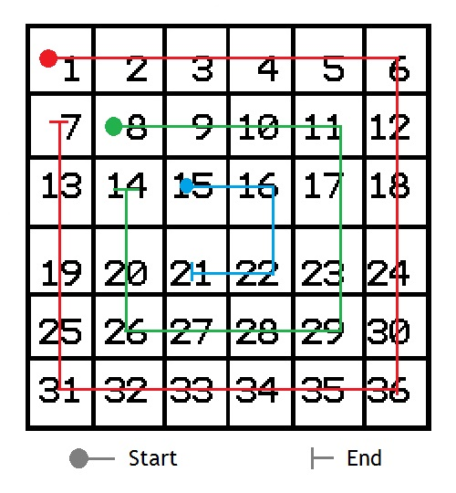
Spiral Matrix Order: Analysis
N = 6
Total Displayed: N*N (stop condition)
Each round: right, down, left, up
Then next round on smaller matrix
Matrix NxN => (N-2) x (N-2)
6 => 4 => 2 => 0
5 => 3 => 1
Even NOT same as ODD
Move 5 (r), 5(d), 5(l), 4(u)
Problem: Common cell from row to next col
Sol: Print/Move - Don’t print last step
Problem: Last value in round NOT printed
Sol: Special print in rounds end
Last, after round, change direction / move
Note, you should analyze ODD case too

Slide 16
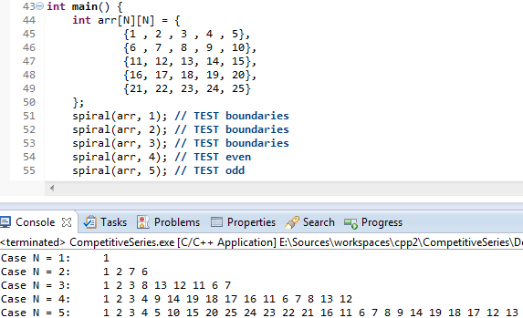
Spiral Matrix Order: Interface

Slide 17
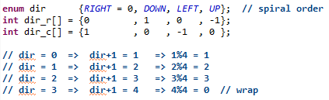
Spiral Matrix Order: Dir Array

Slide 18
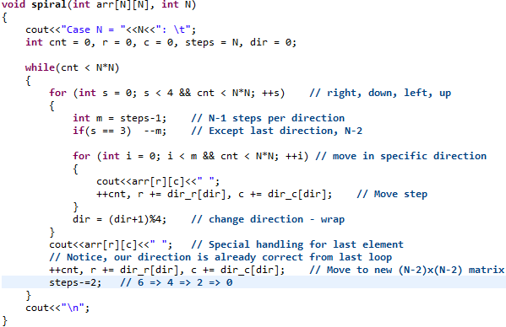
Spiral Matrix Order: Algorithm

Slide 19
Homework: Connect 4 game
Write program to simulate 2 players
Turn by tun, ask player to put his item
Validate it. E.g. Column is 6 items. Column may be full
Print the board after each turn
Check for winner after each turn (revise rules)
Which player starts? Do that randomly using rand() function. Let players enter their names / color
More fun? Make it a player versus Computer

Slide 20
Homework: Magic Square Generation
Magic square generation is not direct
There are 3 types (odd, single even, double even)
e.g. (3, 6, 8)
There are some proposed methods on web to generate them
Try to build program
Given N => Generate Magic Matrix NxN

Slide 21
تم بحمد الله
علمكم الله ما ينفعكم
ونفعكم بما تعلمتم
وزادكم علماً

